Slide 1
Learning to Generalize – Meta Learning for Domain Generalization

Slide 2
Domain Shift
Change in the data distribution between train and test dataset
Standard learning algorithms fails working on different data distribution
Solution – Domain-Agnostic approaches
Multi domain Learning
Training a single model that is effective for multiple known domains.
Domain Adaptation
Domain Generalization
Domain Generalization
Train a model for each source domain
Extract domain-agnostic component
Learning a domain-invariant feature representation

Slide 3
Meta Learning
Model capable of adapting or generalizing to new tasks and new environments that have never been encountered during training time.
Three common approaches
Metric based
Model based
Optimization based
Meta Learning for Domain Generalization
S Source domain
T target domain
Domain generalization aims for training a single parameterized model on source domains, such that it generalizes to target domains.
Source domain split into two parts
S-V meta-train domain
V meta-test domain
This model-agnostic approach applied for supervised and reinforcement learning

Slide 4
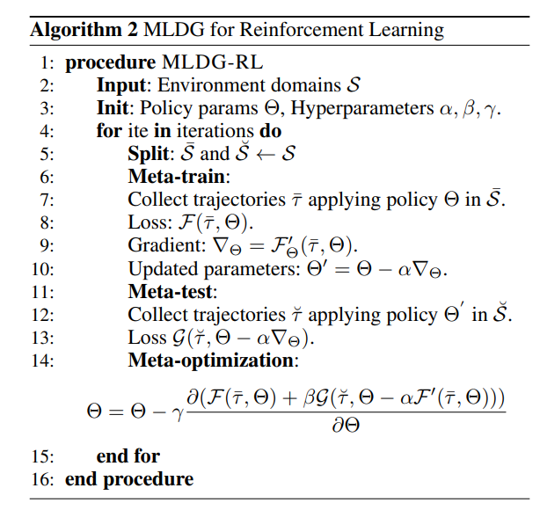
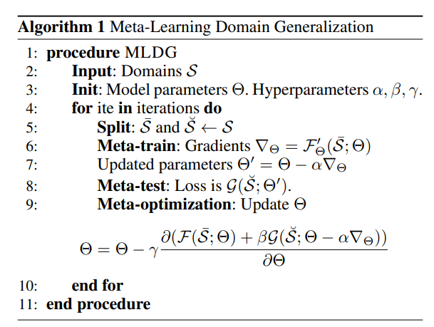

Slide 5
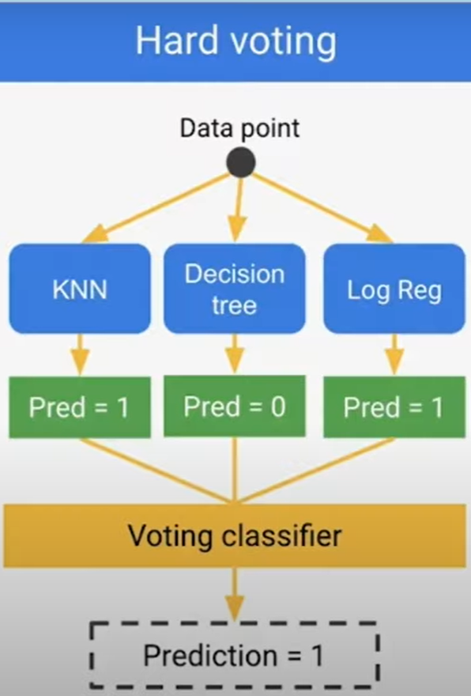
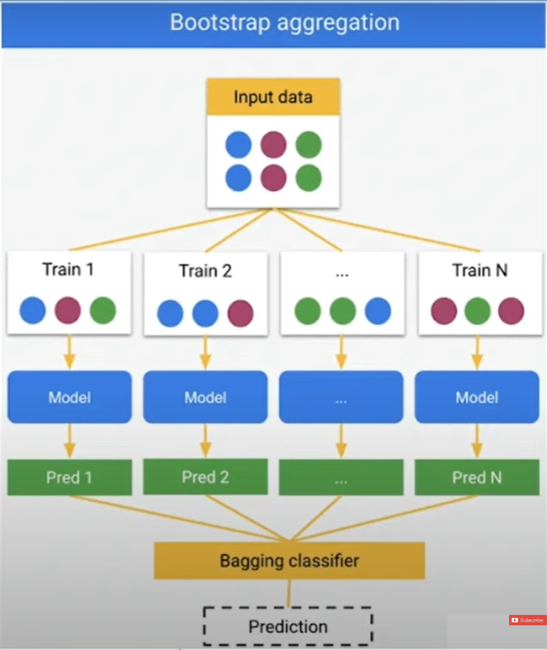
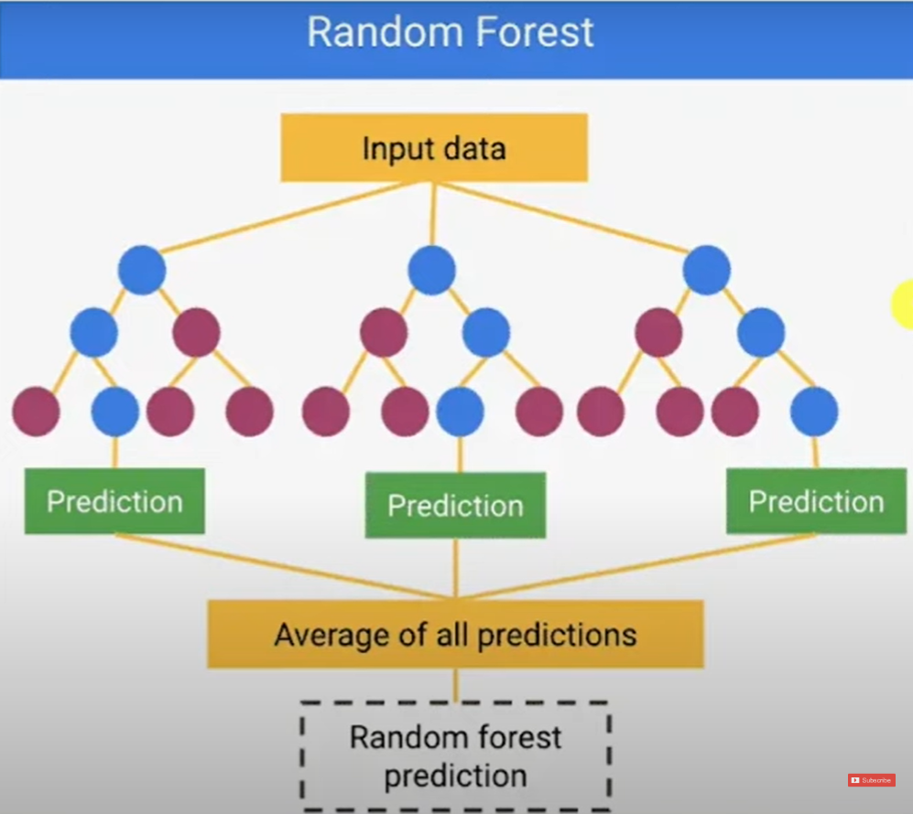
Ensemble learning
It is a supervised learning technique used in machine learning to improve overall performance by combining the prediction from multiple models.
Types of ensemble learning
Voting(Averaging)
Bootstrap aggregation(bagging)
Random Forests
Boosting
Stacked Generalization

Slide 6
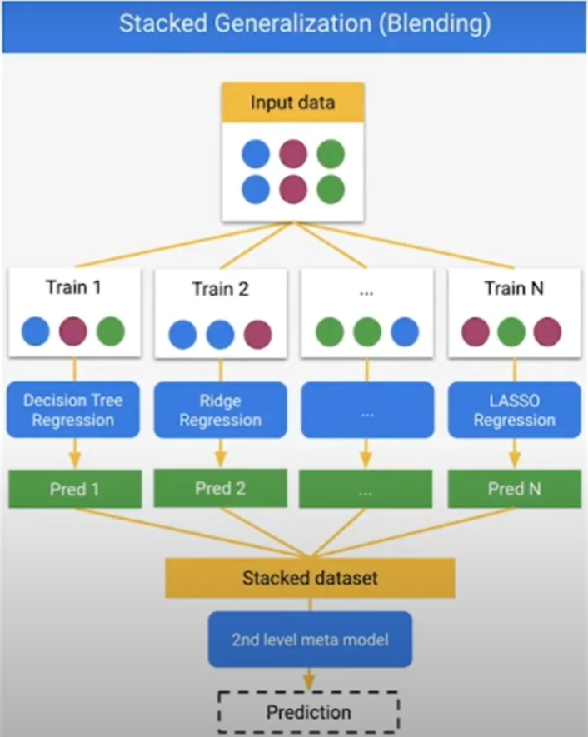
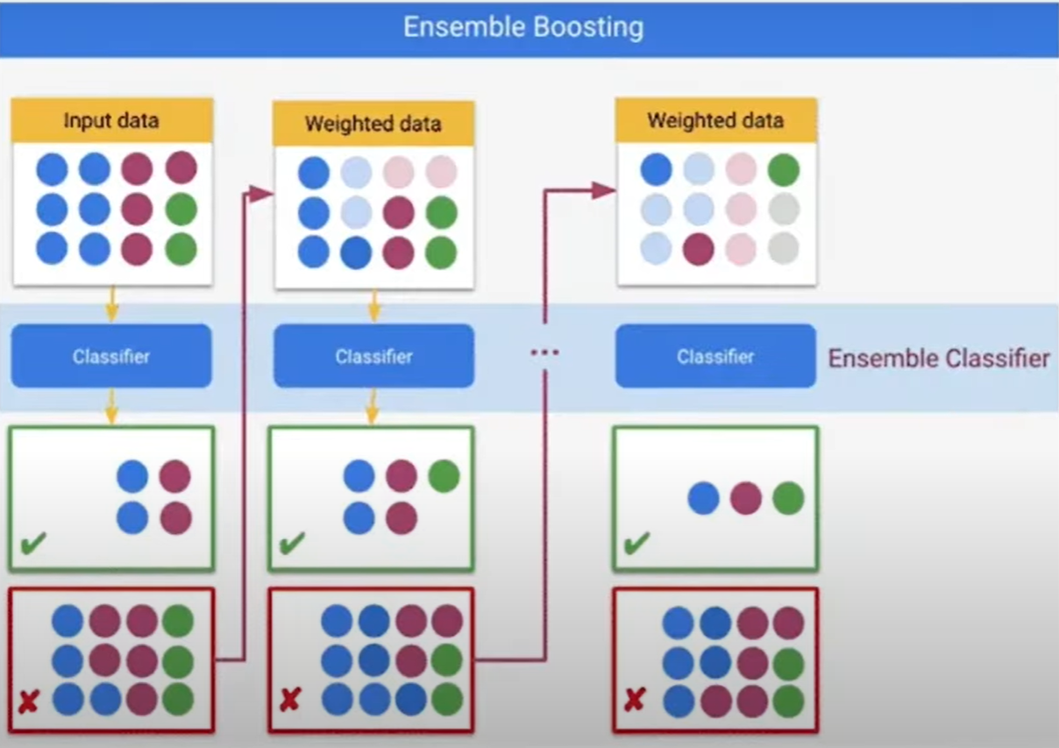

Slide 7
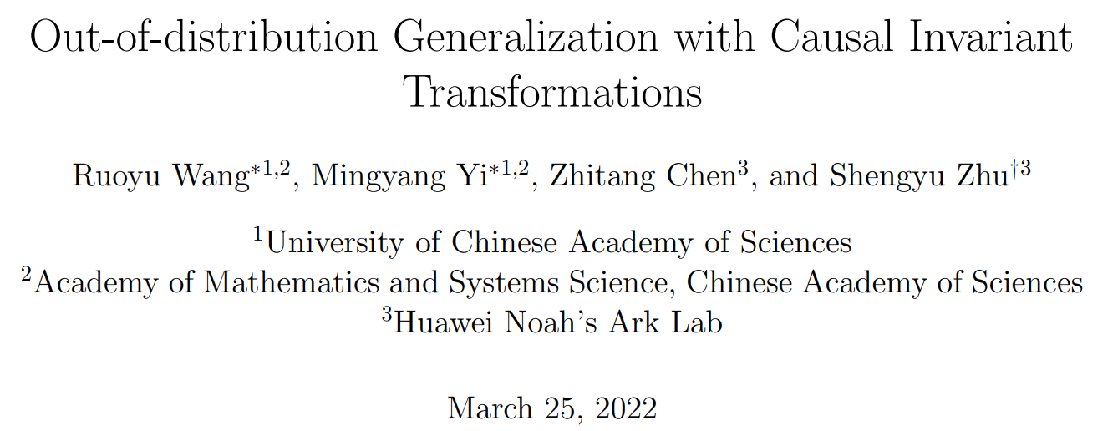
Paper Link : https://openaccess.thecvf.com/content/CVPR2022/papers/Wang_Out-of-Distribution_Generalization_With_Causal_Invariant_Transformations_CVPR_2022_paper.pdf

Slide 8
Approach
Keep causal part unchanged and modify the non causal feature based on transformation.
Proposed regularized training procedure to improve the OOD generalization.
Causality for OOD – based on the assumption/observation that causal features are invariant, even data distributions are vary with domains.
Learn a model that takes advantages of the invariant properties – transformation that modify the input data but do not change their causal features.
OOD Generalization via Causality
Invariant Causal Mechanism
Generalization via Causal Features
Learning via Causal Invariant transformation
Learning via Causal Essential Set
Necessity of prior knowledge

Slide 9
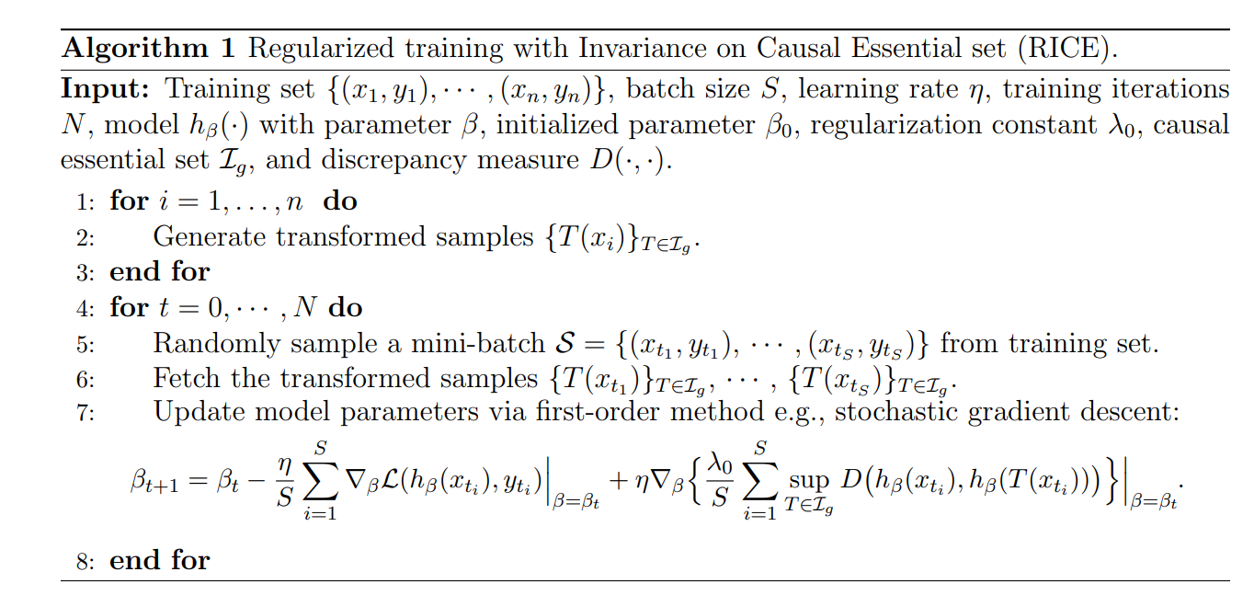
RICE enables an improved OOD generalization, even with the set of only a few CITs.
Algorithm RICE regularizes the model invariant to the changes in spurious features.

Slide 10
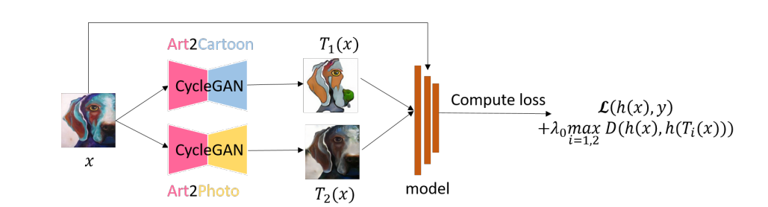
Experiment
Classified OOD data into two categories
Data with correlation shift
Data with diversity shift
RICE algorithm on the PACS dataset
Training data domains {Art, Cartoon, Photo}
Test Domain {Sketch}
RICE – Make predictions on top of causal features, rather than spurious feature related to the domains.

Slide 11
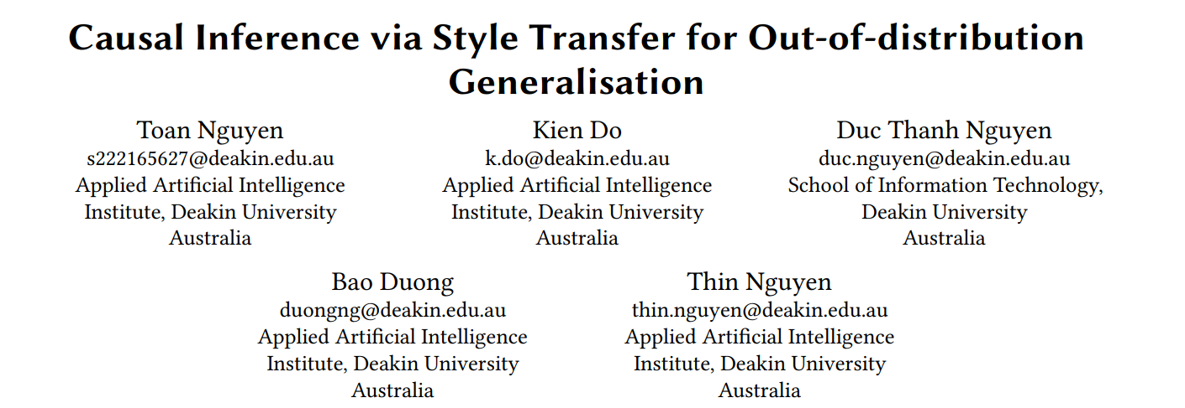
Paper link : https://arxiv.org/abs/2212.03063

Slide 12
Causal Inference Method - Back-door adjustment cannot be applied to remove spurious correlations as it requires the observation of confounders.
A novel method that effectively deals with hidden confounders by successfully implementing front-door adjustment (FA).
Method
A formulation of OOD generalization under the perspective of causal inference.
A causal inference solution to OOD generalization based on FA, which successfully implemented by two different style transfer strategies.
Neural Style transfer
Fourier based Style transfer
Extensive experiments on various benchmark datasets.

Slide 13
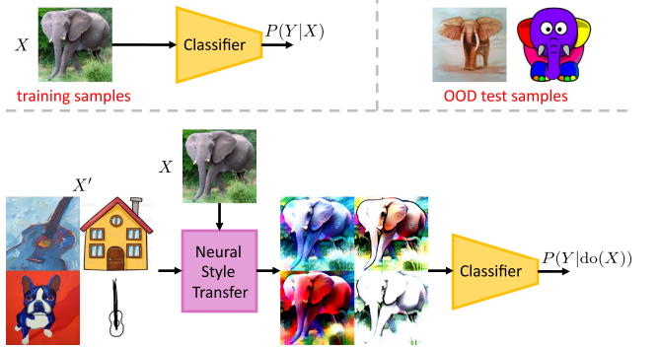
A model of 𝑃 (𝑌 |𝑋) tends to capture all associations between 𝑋 and 𝑌 including the spurious dependence.
A model of 𝑃 (𝑌 |do(𝑋)) only captures the causal dependence 𝑋 → 𝑌. 𝑃 (𝑌 |do(𝑋)) can be identified via front door adjustment by leveraging style transfer.
do(x) – Removes all spurious associations between X and Y.
FA requires the choice of mediator – Semantic information of image that helps across the causal dependences.
That is “Feature extracted from images that are always predictive of labels”.

Slide 14
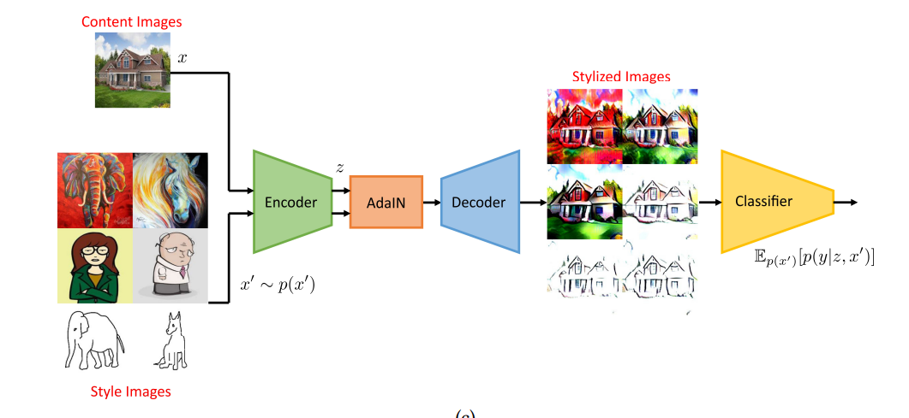
𝑥’ = AdaIN_NST(𝑥, 𝑥′ )
𝑥’ will capture the semantic feature 𝑧 of 𝑥 and the style of 𝑥 ′ properly.
Compute the label of 𝑥’ by feeding this stylized image through the classifier.
Style transfer models – Not only transfer artistic styles but also effectively capture the semantic content of images.

Slide 15
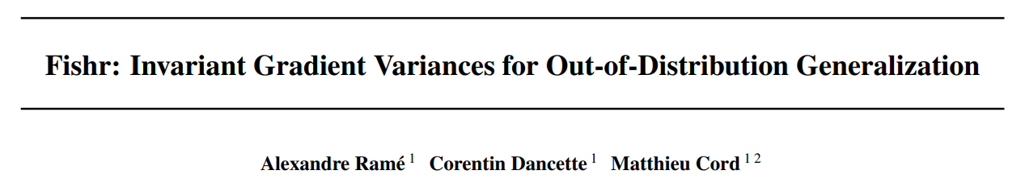
Paper Link : https://arxiv.org/abs/2109.02934

Slide 16
Fishr regularization
New regularization for OOD generalization keeps extra information from individual gradients and matches across domains.
Domain invariance in the space of gradients of the loss. Specifically, the domain-level variances of gradients are matched across training domains.
Learns weights so that parametrized model predict well on a new test domain.
Parameterized model should ideally capture an invariant mechanism across training domain.
Invariance via a regularization criterion only differ by the choice of statistic to be matched across training domain.

Slide 17
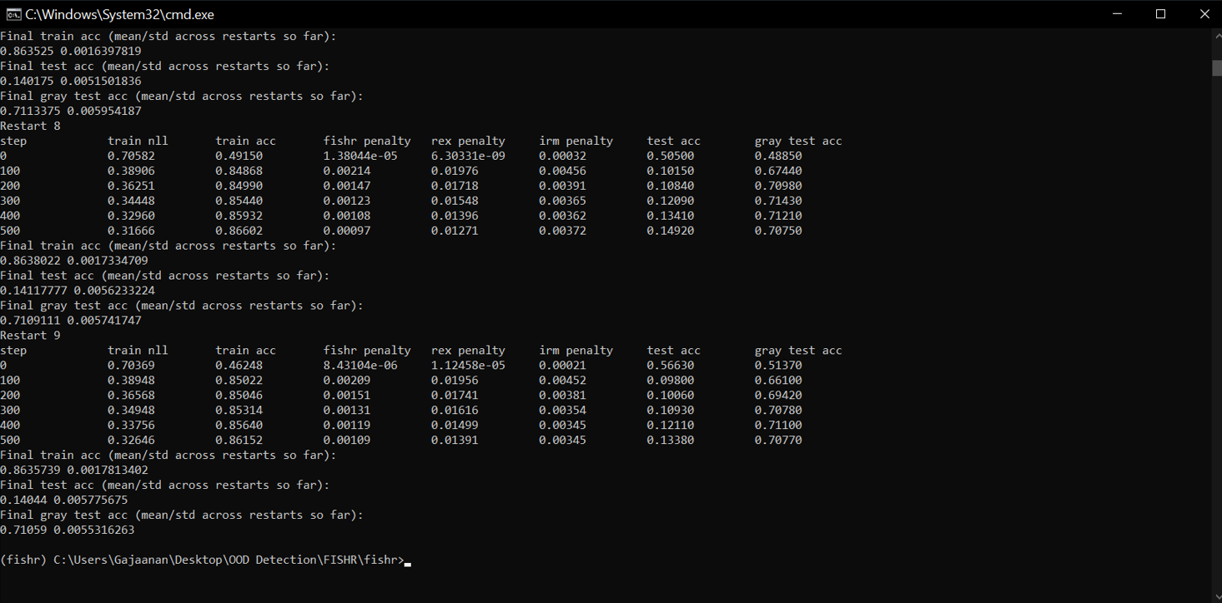

Slide 18
Problem Statement
Traditional machine learning paradigms are based on the assumption that both training and test data follow the same statistical pattern. (Mathematically referred to as Independent and Identically Distributed (i.i.d)).
In real-world applications, this i.i.d. assumption often fails to hold due to unforeseen distributional shifts, leading to considerable degradation in model performance upon deployment.
Problem with high risk domains
Health care
Autonomous driving
Need to enhance the robustness and reliability of intelligent systems across diverse real-world scenarios.

Slide 19
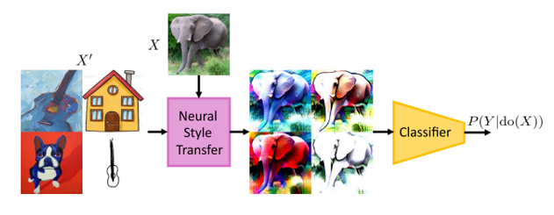
Causal Inference via style transfer for out of distribution generalization
Method
A formulation of OOD generalization under the perspective of causal inference.
A causal inference solution to OOD generalization based on FA, which successfully implemented by two different style transfer strategies.
Neural Style transfer
Fourier based Style transfer
Extensive experiments on various benchmark datasets.
PACs
Office-Home
Digits-DG
Limitations
A model of 𝑃 (𝑌 |do(𝑋)) only captures the causal dependence 𝑋 → 𝑌. 𝑃 (𝑌 |do(𝑋)) can be identified via front door adjustment by leveraging style transfer.

Slide 20
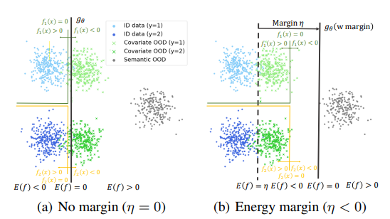
Feed Two Birds with One Scone: Exploiting Wild Data for Both Out-of-Distribution Generalization and Detection.
Method
A new unified approach that is capable of simultaneously generalizing to covariate shifts while robustly detecting semantic shifts.
Optimize for a binary classifier based on energy function.
Extensive experiments on various benchmark datasets.
In-distribution data – CIFAR-10
Covariate-shifted data – CIFAR-10-C
Semantic-shifted data – SVHN, Textures, Places365,
LSUN-Crop, LSUN-Resize
Limitation

